Slide 1
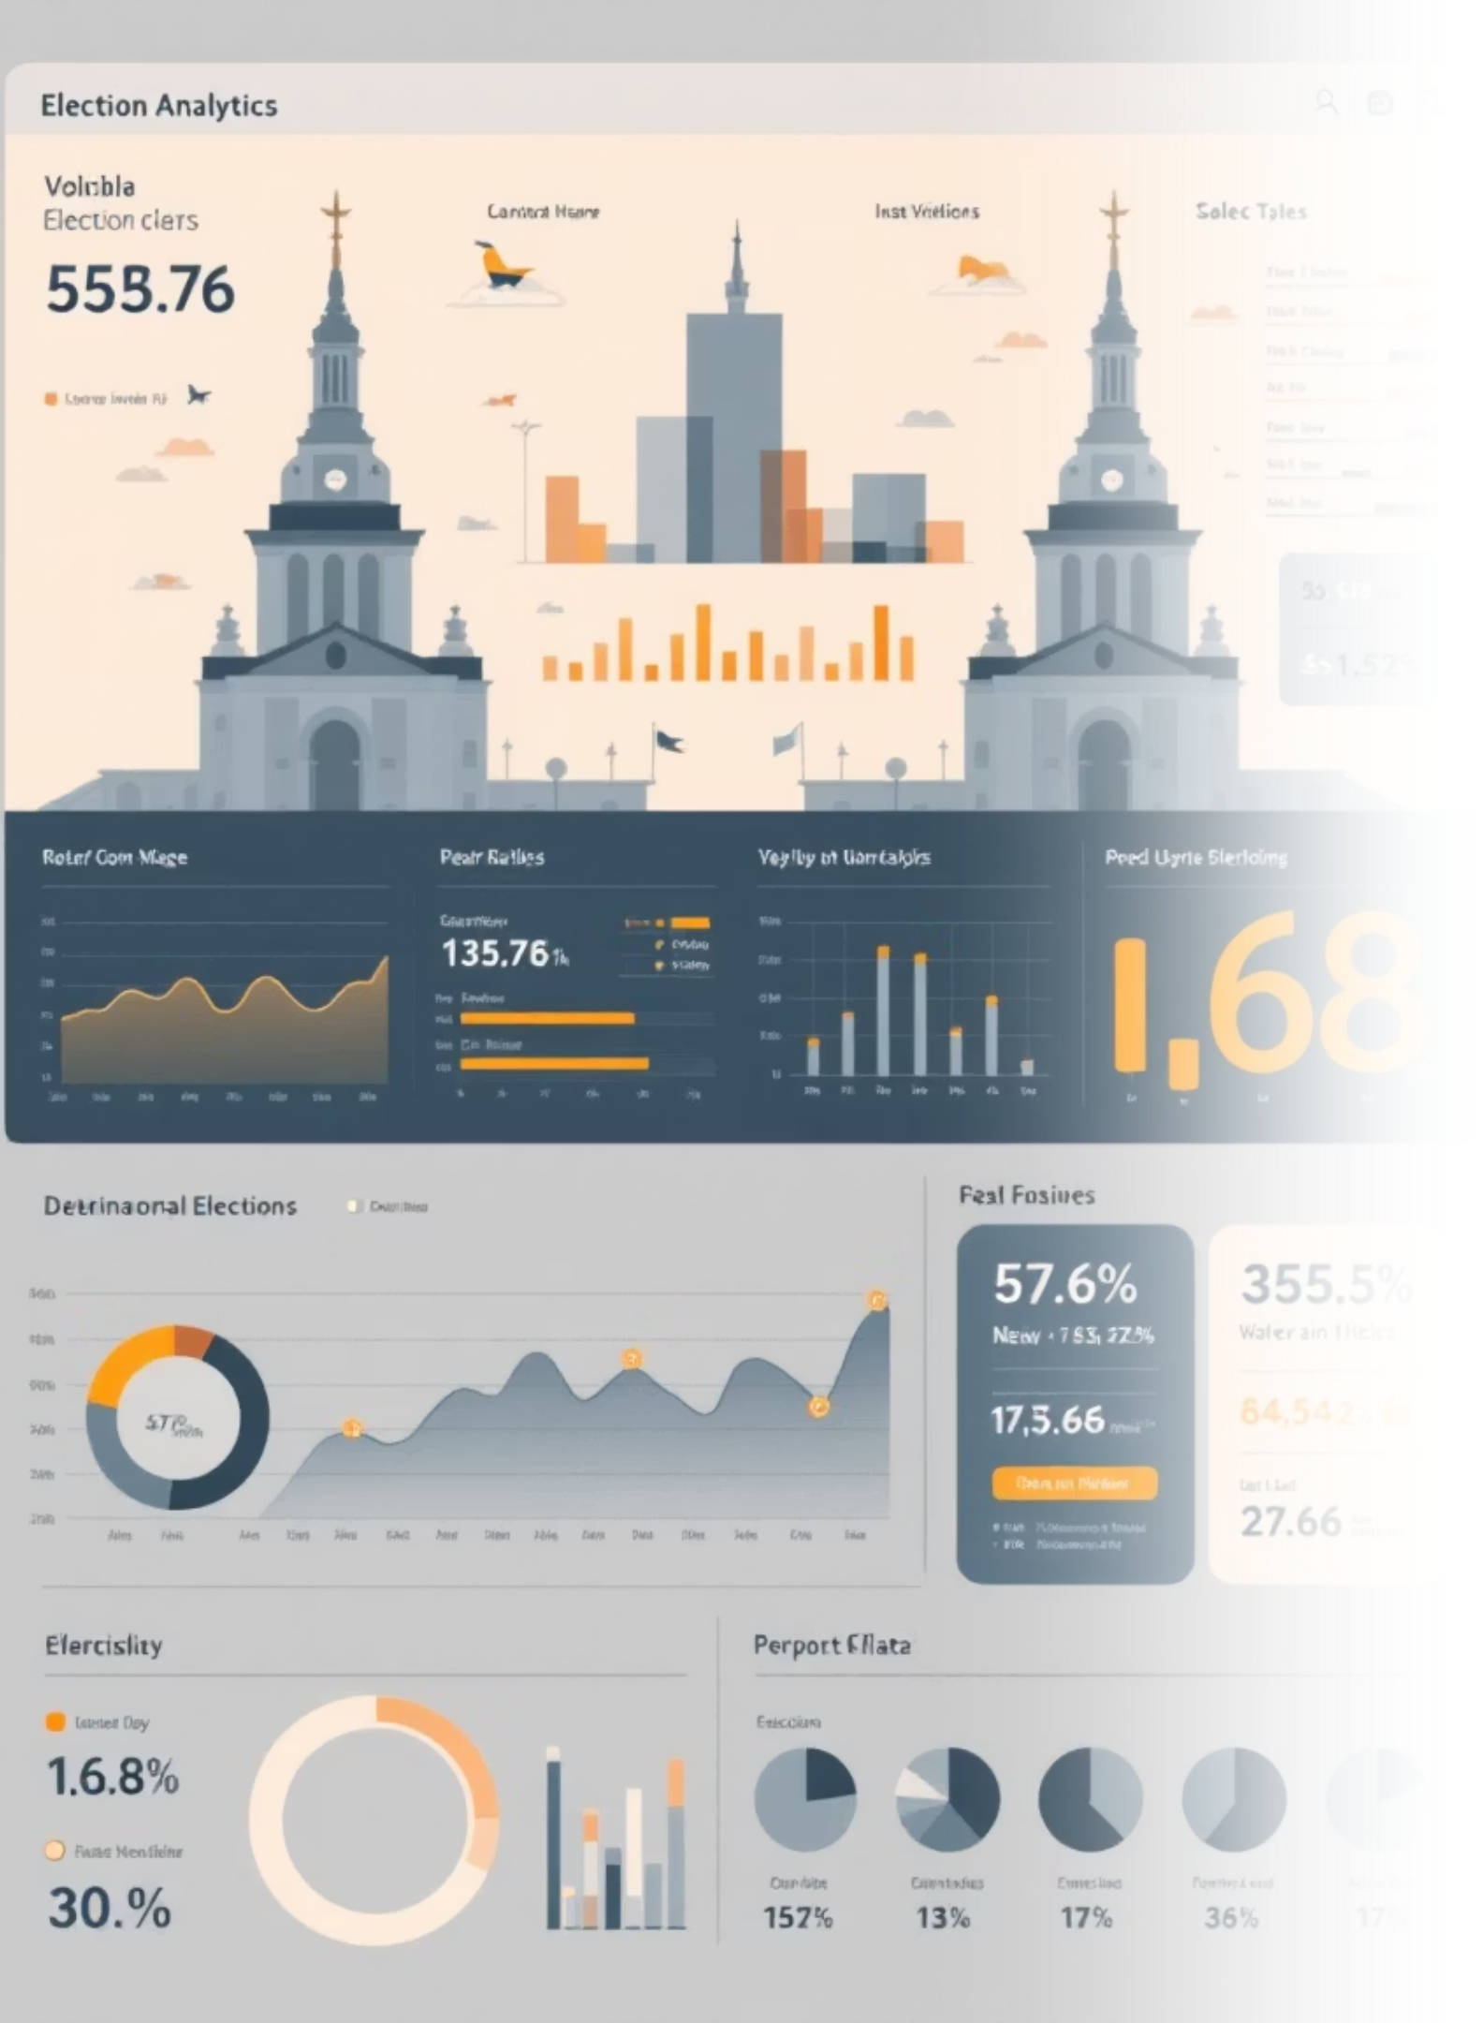
Visualizing Election Data for a News Company
A comprehensive multi-zone interactive platform for analysing party and candidate performance across constituencies. This dashboard empowers election analysts and designers with real-time insights, historical trends, and demographic breakdowns to track win/loss margins, re-election patterns, and drill down to constituency-level data with party-wise and alliance-wise seat share visuals.

Slide 2






Meet Our Project Team
Abhishek
Divya (Leader)
Anjali
Dashboard skeleton development, overview KPIs, and filter implementation
Historical trends visualisation and data integration specialist
Real-time results block development and live data feeds
Jannath
Asmitha
Demographics analysis, visualisations, and presentation preparation
Party and candidate insights, final design polish, and bookmarks

Slide 3






Project Workflow & Collaboration
Foundation
Abhishek builds the dashboard skeleton with overview KPIs and filters
Historical Layer
Divya integrates historical trends visuals into the left section
Real-Time Data
Anjali adds the central real-time results block
Demographics
Jannath develops the right section with voter demographics
Final Polish
Asmitha completes party and candidate block plus design refinements

Slide 4

Abhishek's Module: Executive Summary
Top Row Overview
The executive summary row provides at-a-glance insights into the election landscape. Key performance indicators include total votes cast, voter turnout percentage, the leading party, and total seats available. An intuitive slicer bar enables filtering by year, party, and region, allowing analysts to quickly pivot their analysis and explore different scenarios.
This foundation covers Milestone 1 basics and establishes the core overview framework.

Slide 5

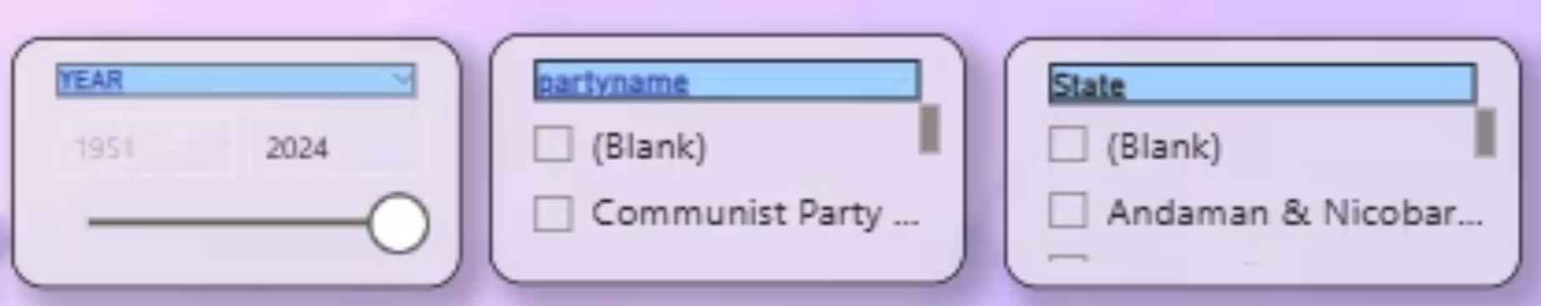
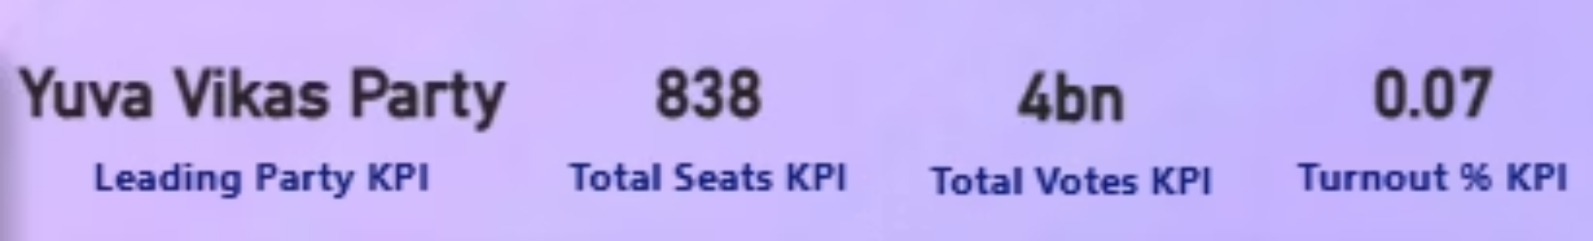

Slide 6
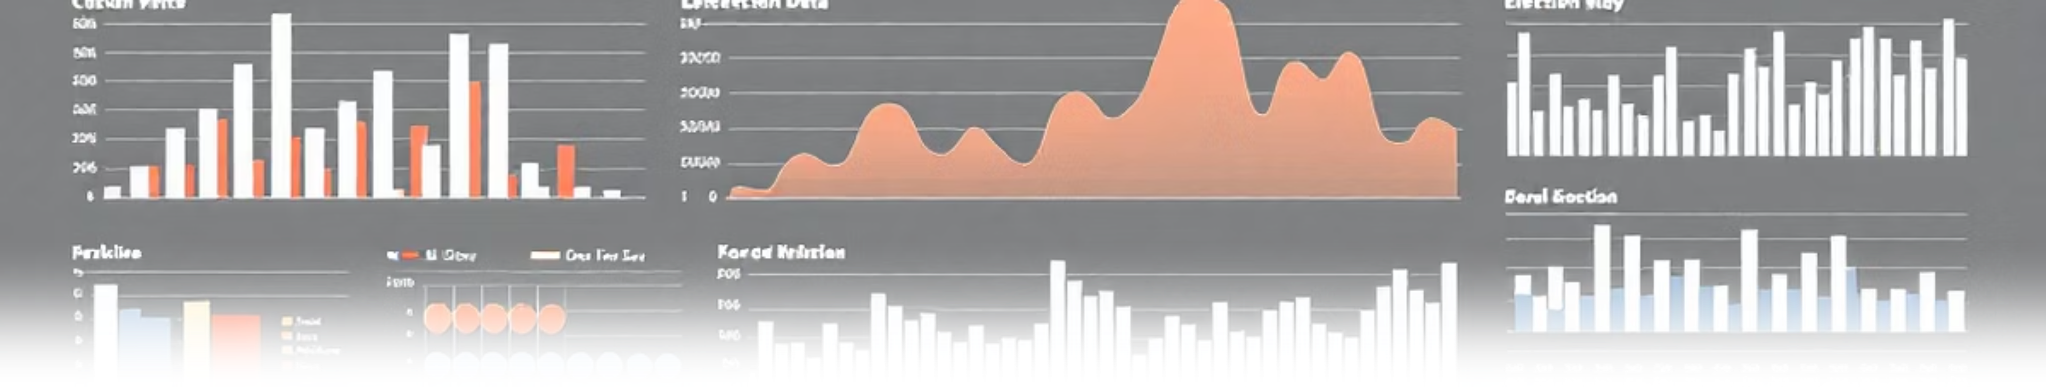
Divya's Module: Historical Trends Analysis
1
2
3
Vote Share Evolution
Turnout Trends
Swing Constituencies
Interactive line chart tracking vote share changes across multiple election years, revealing long-term party performance patterns
Bar chart visualisation displaying voter turnout percentages by year, identifying engagement patterns and participation fluctuations
Conditional formatting highlights constituencies with significant vote swings, helping analysts spot competitive regions and shifting voter sentiment
This comprehensive historical analysis forms the left section of the dashboard and delivers Milestone 2 requirements.

Slide 7

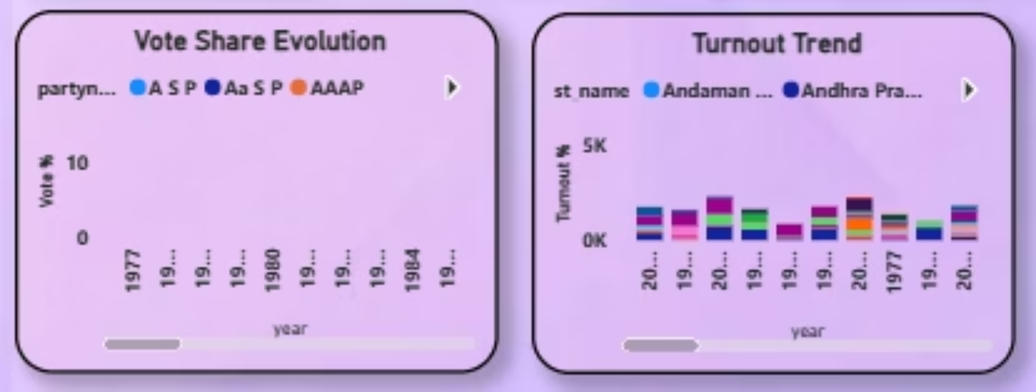

Slide 8


Anjali's Module: Real-Time Results
Live Election Tracking
The centre section delivers up-to-the-minute election results as votes are counted. Dynamic seat count cards display party-wise performance, whilst interactive vote percentage bar charts provide instant visual comparison across all competing parties.
This real-time module fulfils Milestone 3 and serves as the dashboard's beating heart, updating continuously as results flow in.

Slide 9

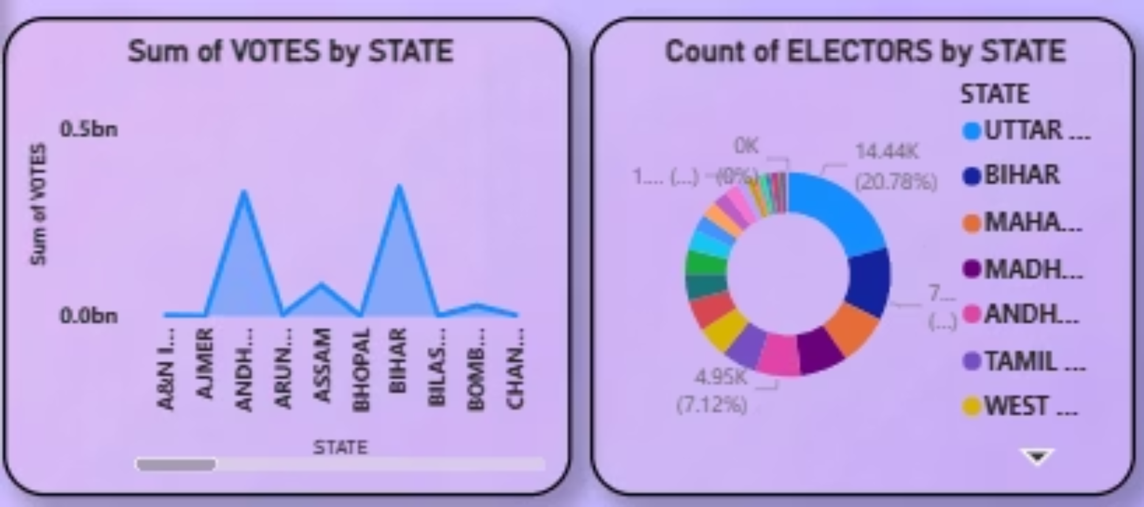

Slide 10
Jannath's Module: Voter Demographics
Gender-Wise Turnout
Age Group Analysis
Urban vs Rural Patterns
Interactive pie chart breaking down voter participation by gender, revealing engagement patterns across male, female, and other categories
Bar chart visualisation segmenting turnout by age brackets, identifying which demographics are most politically active
Heatmap comparing voting behaviour and turnout between urban centres and rural constituencies, highlighting geographic trends
This right-section demographic analysis completes Milestone 4 and provides crucial insights into voter composition.

Slide 11

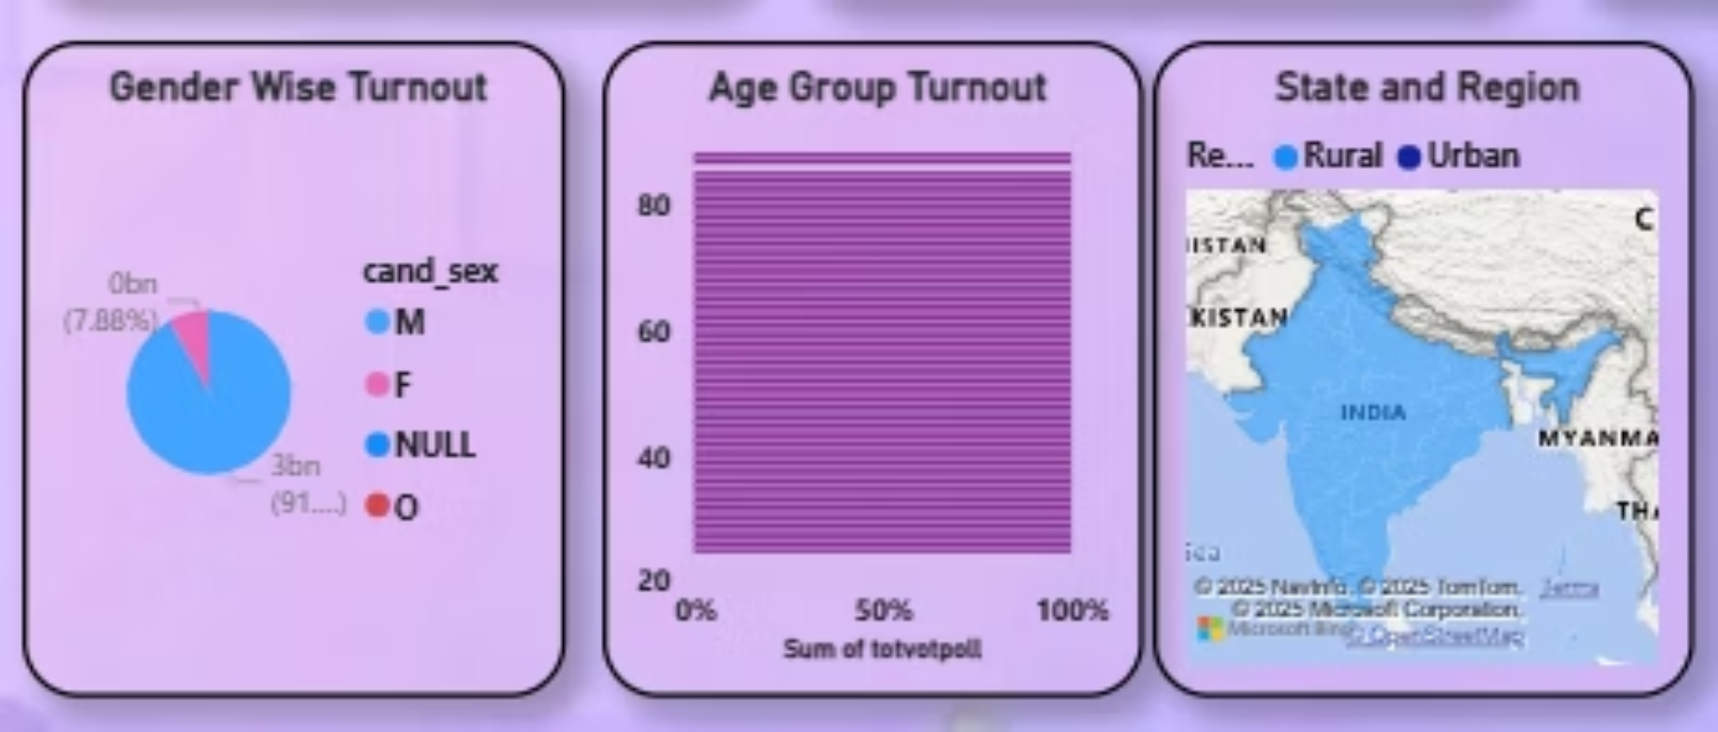

Slide 12
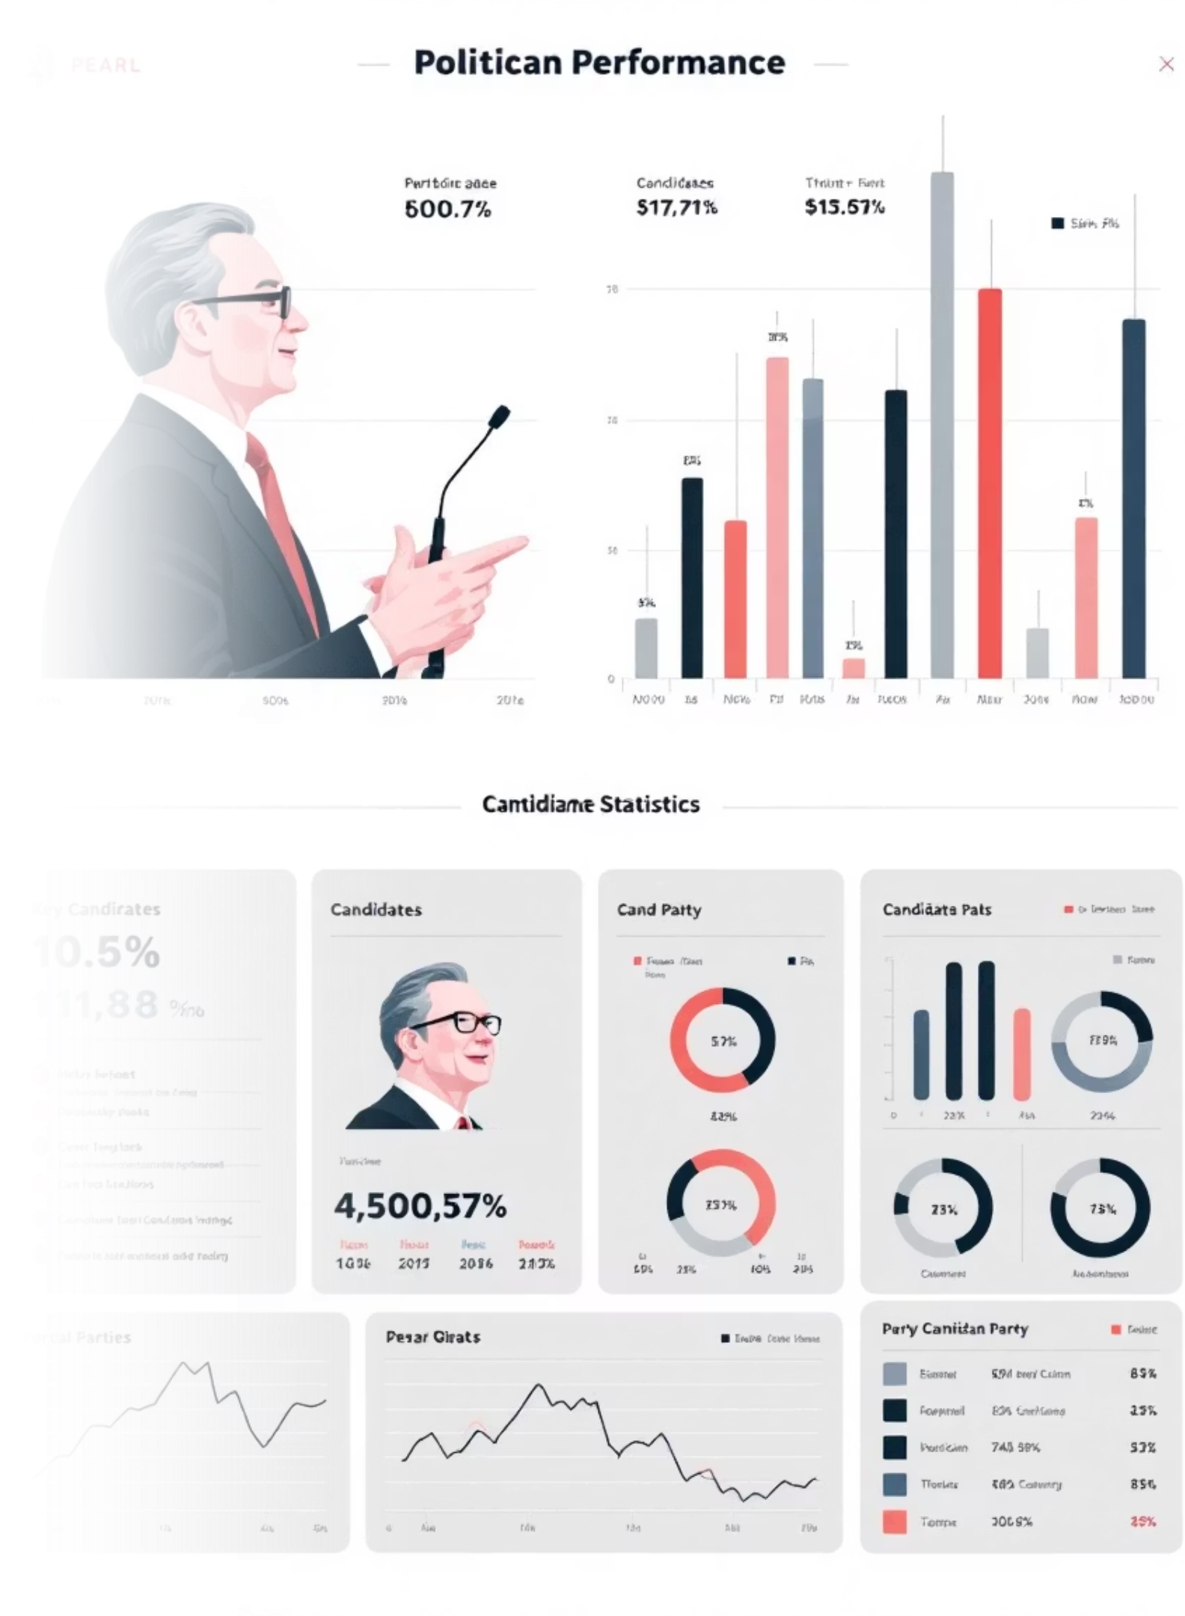
Asmitha's Module: Party & Candidate Performance
Bottom Section: Comprehensive Performance Analysis
Party Seats Comparison
Candidate Performance Table
Stacked bar chart offering side-by-side comparison of seat wins across all parties and alliances, revealing coalition dynamics and majority formations
Detailed tabular view showcasing individual candidate results including total votes received, victory margins, and percentage share

Slide 13

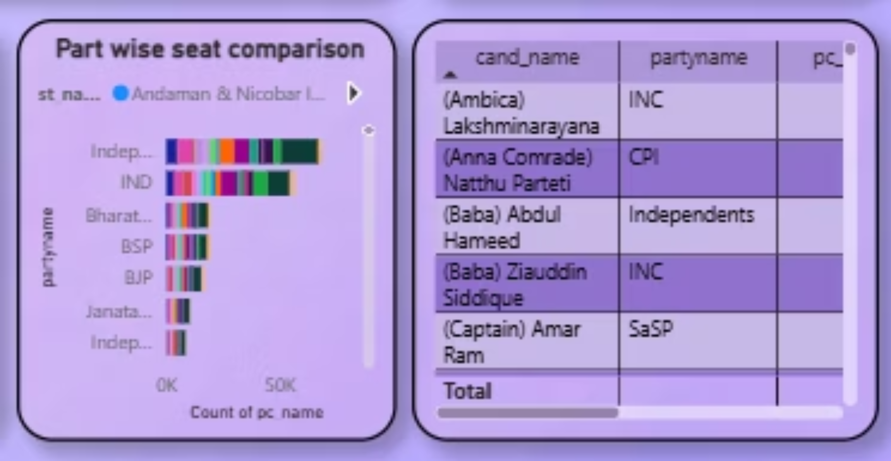

Slide 14


Dashboard Design & Final Polish
Design Excellence
Asmitha leads the final design refinement phase, ensuring visual consistency, intuitive navigation, and professional aesthetics across all dashboard sections.
User Experience Focus
Responsive layouts adapt seamlessly across devices, whilst colour coding and conditional formatting guide users' attention to critical insights. The design balances data density with clarity, ensuring analysts can extract insights quickly without cognitive overload.

Slide 15

Project Deliverables
Interactive Dashboard
Presentation Materials
Fully functional multi-zone platform with five integrated sections covering KPIs, historical trends, real-time results, demographics, and candidate performance
Comprehensive PowerPoint presentation, documenting project architecture, features, and usage guidelines for stakeholders
Documentation
Technical specifications, user manuals, and data source documentation ensuring smooth handover and future maintenance
Ready to transform election analysis — Our collaborative effort delivers a powerful tool enabling deeper insights into democratic processes, empowering analysts to understand voting patterns, predict trends, and communicate findings effectively.

Slide 16
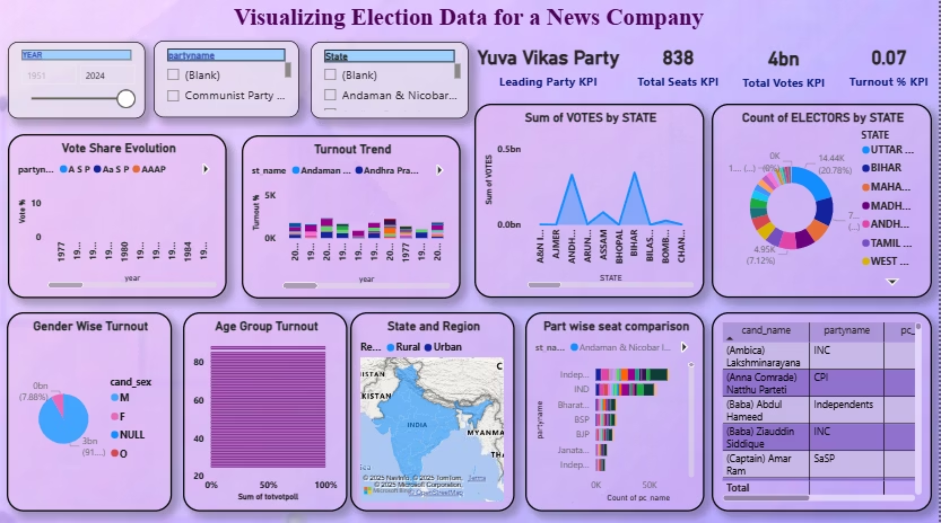

Slide 17
THANK YOU

